Slide 1
fun main() {
println(“Hello Everyone!!”)
}

Slide 2
Introduction to IT
By Group 01
Copyright © 2019 Designed by Hafizh Hakim

Slide 3
Agenda :
The tools needed
How to Disassemble Computer
Hot to Assemble Computer
What we find in our computer
What we find in our friend’s computer

Slide 4
The tools needed
Tools 1
Tools 2
Tools 3 (we do not use but it is recommended to use)
Screwdriver Plus
Function To remove and install bolts plus those used when assembling a computer
Paint brush
useful for cleaning computer hardware that has dust
Screwdriver Minus
Its function is almost the same as the different Screwdriver Plus, only the Minus screwdriver is used for minus bolts
Tissue
useful for cleaning dust and can be a base for the computer hardware components
Mask
useful to protect us from flying dust
Camera / Phone Camera
useful for documenting computer assembly activities
Taper Pliers (crocodile claws)
Serves to clamp small objects
Tweezers
Serves to take bolts / small material from a computer assembly
Antistatic Bracelet
The tool is used to prevent electrostatic discharge

Slide 5
HOW TO ?
Disassemble and Assemble Computer Component

Slide 6
Disassemble Computer Component
Assemble Computer Component
Take of the case
Unplug every wire who coming from power supply
Unplug the screw holding the CD-ROM
Unplug the fan wire
Unplug the CPU Fan from Motherboard
Take of the RAM
Remove the CPU
Unplug the wire from hard disk
Unscrew the screw holding
Screw the motherboard
Mount the CPU
Attach the RAM
Mount the power supply
Mount the hard disk
Connect the SATA connector to the drivers
Connect the 24 pin ATAX connector
Mount the DVD-ROM
Take the casing back

Slide 7
WHAT ????
The component we find in our computer

Slide 8
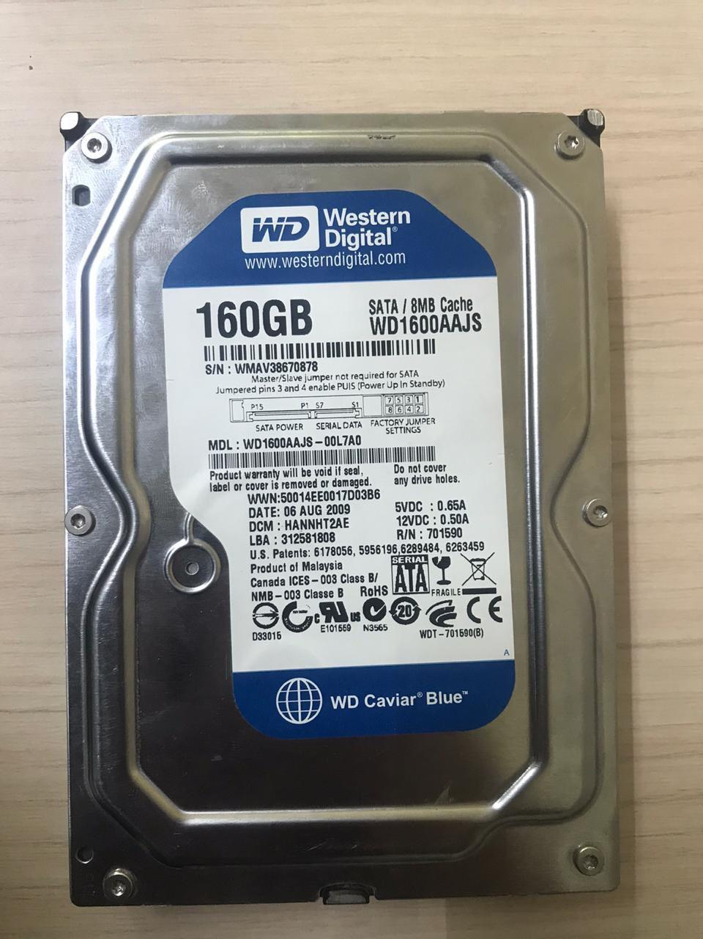
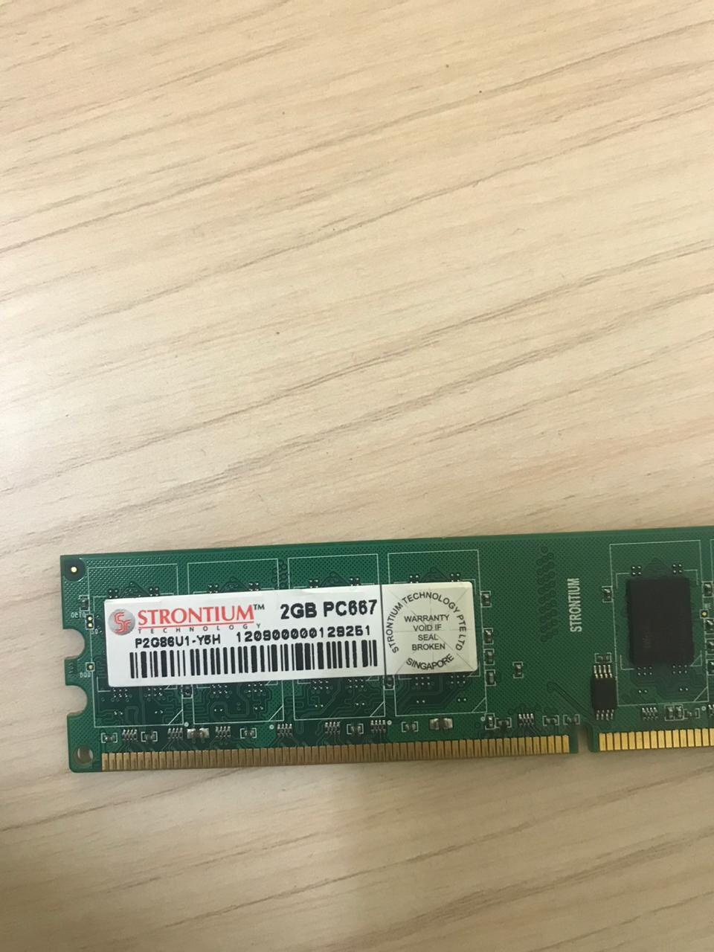
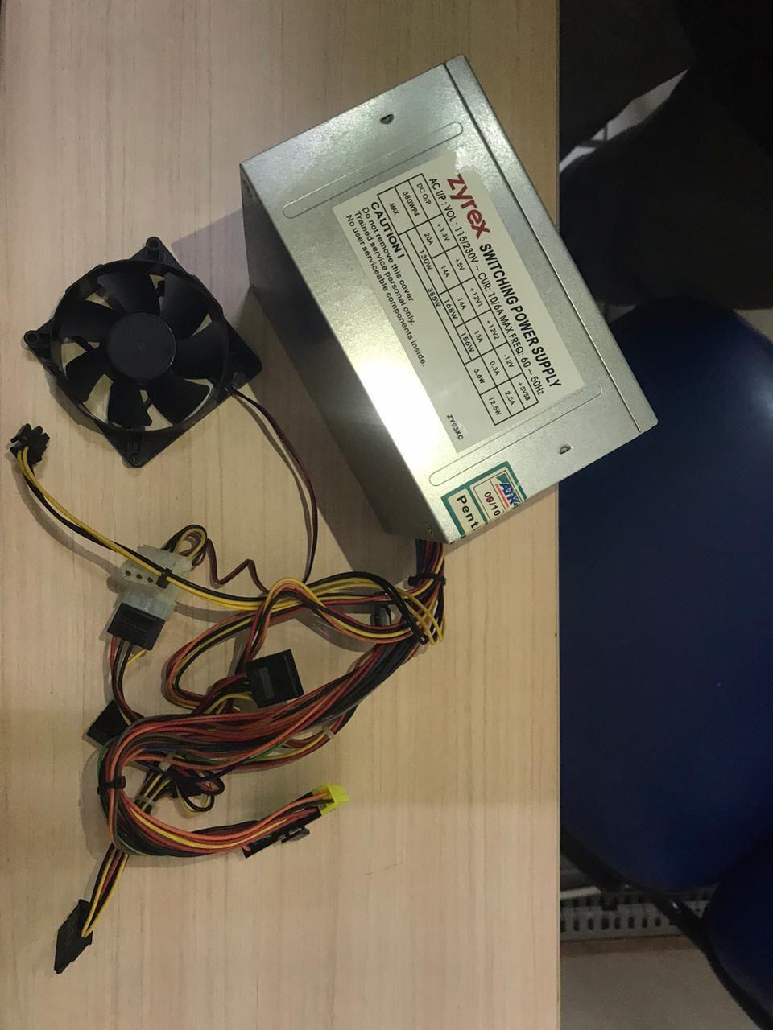
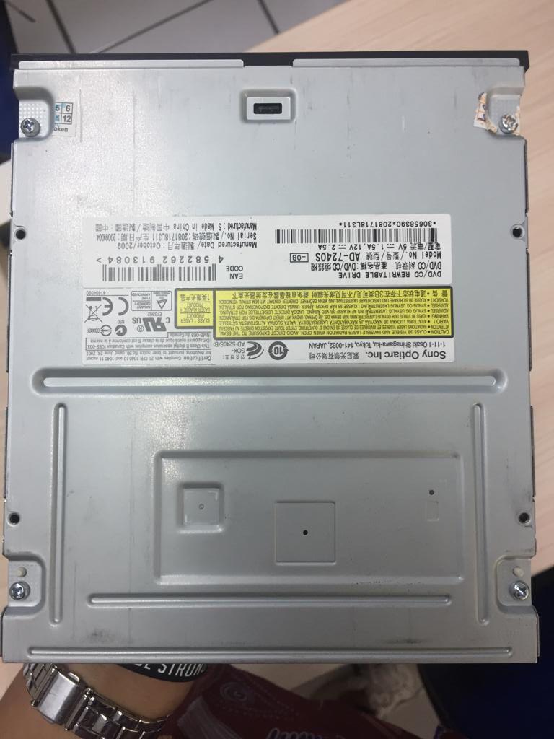
Hard disk Internal
Random Access Memory
Power Supply
CD-ROM
Brand : Western Digital
Size : 160 GB
Type : WD 1600 AAJS-OOL7AD (SATA)
Function : as storage in computer to save our data
Brand : Strontium Tech
Size : 2 GB
Type : DDR2
Function : to store data for short-term use
Brand : Zyrex
Size : 385 W
Type : BTX
Function : to convert electrical power
Brand : Sony Optiarc Inc.
Function : to read data from a CD. CD-ROM also means that the CD-ROM drive which can only be used to read a CD.

Slide 9
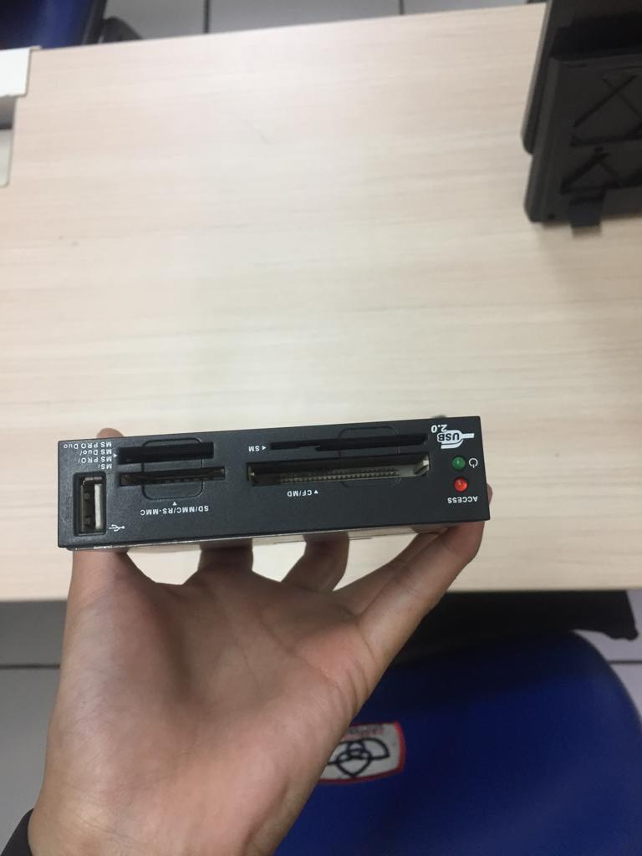
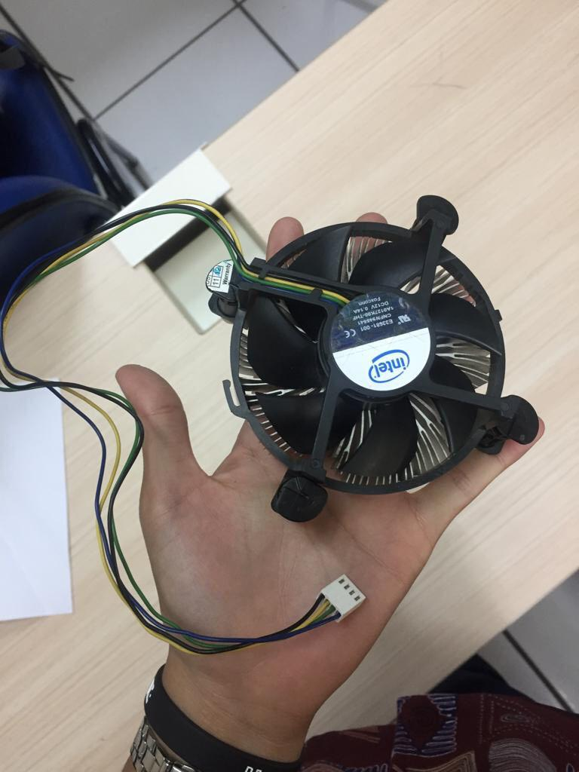
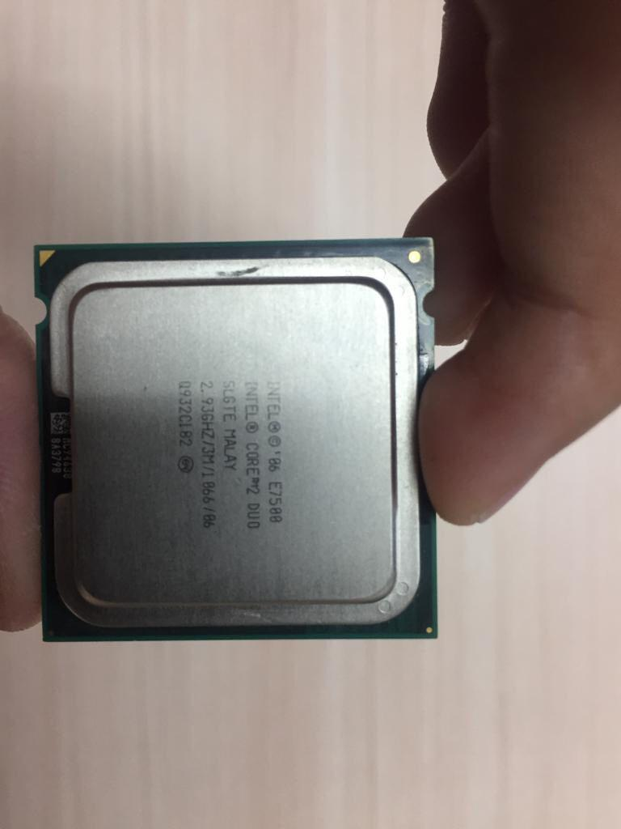
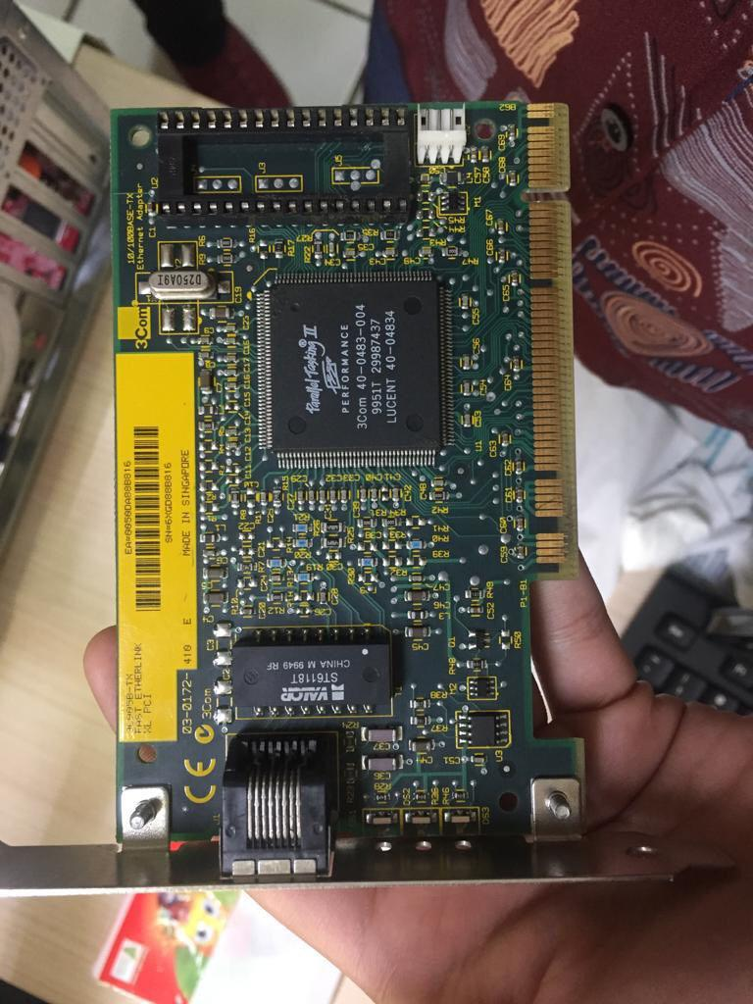
Additional Port USB 2.0
Processor’s Fan
Processor
LAN Card
Brand : EVO Tech
Size : -
Type : -
Function : read portable flash
Brand : Intel
Size : -
Type : -
Function : to pull cooler air into the computer
Brand : Intel
Size : -
Type : Core 2 Duo
Function : Carries out the instruction of a computer program
Brand : -
Type : 100 Mb
Function : Create a physical connection to the network

Slide 10
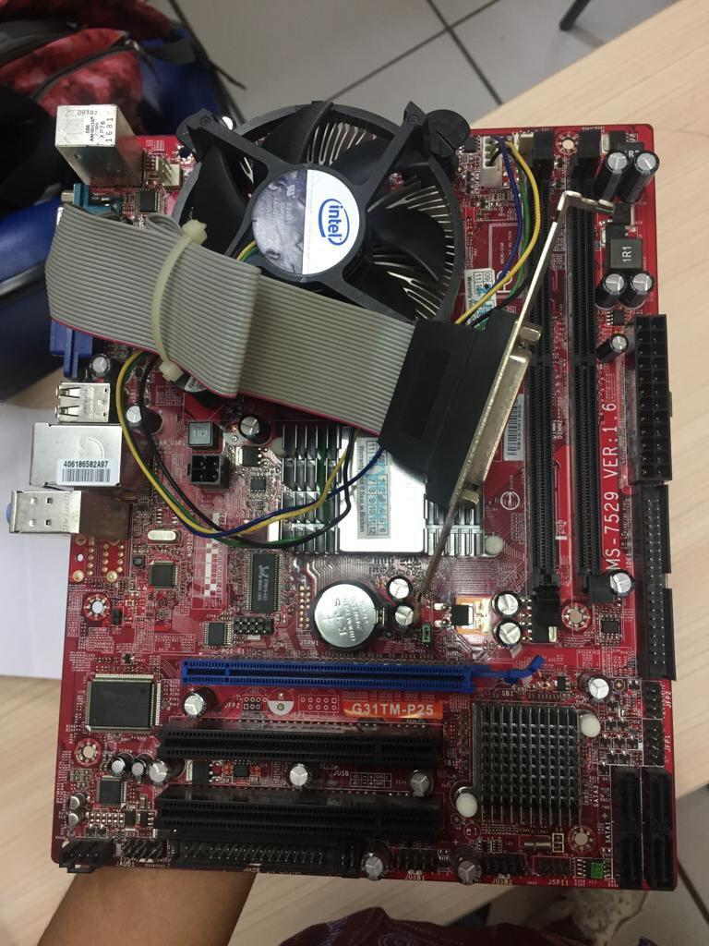
Motherboard
Brand : Zyrex
Type : MS-7529 Ver : 1.6. (Micro ATX)
Function : the function of the motherboard in general is to connect all the components of a computer

Slide 11
WHAT ???
The component we find in our friend’s computer

Slide 12
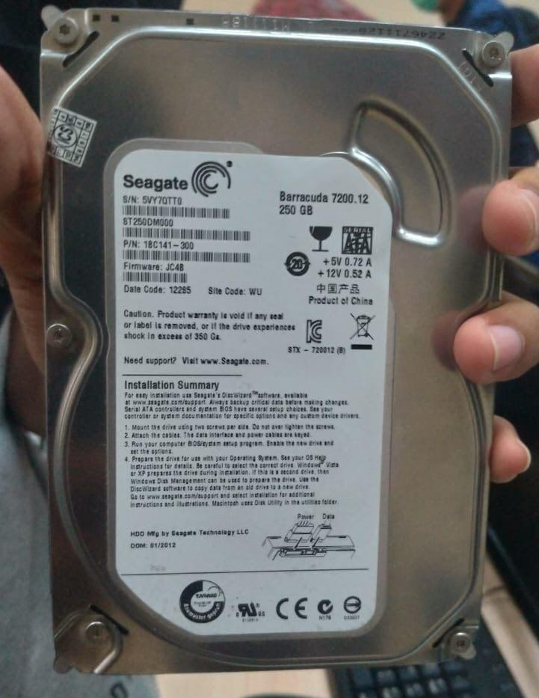
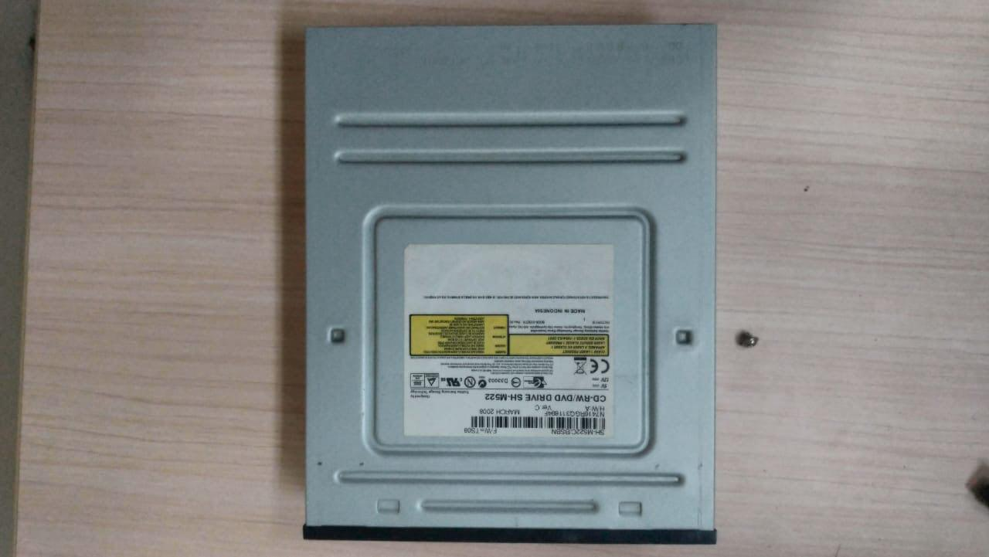
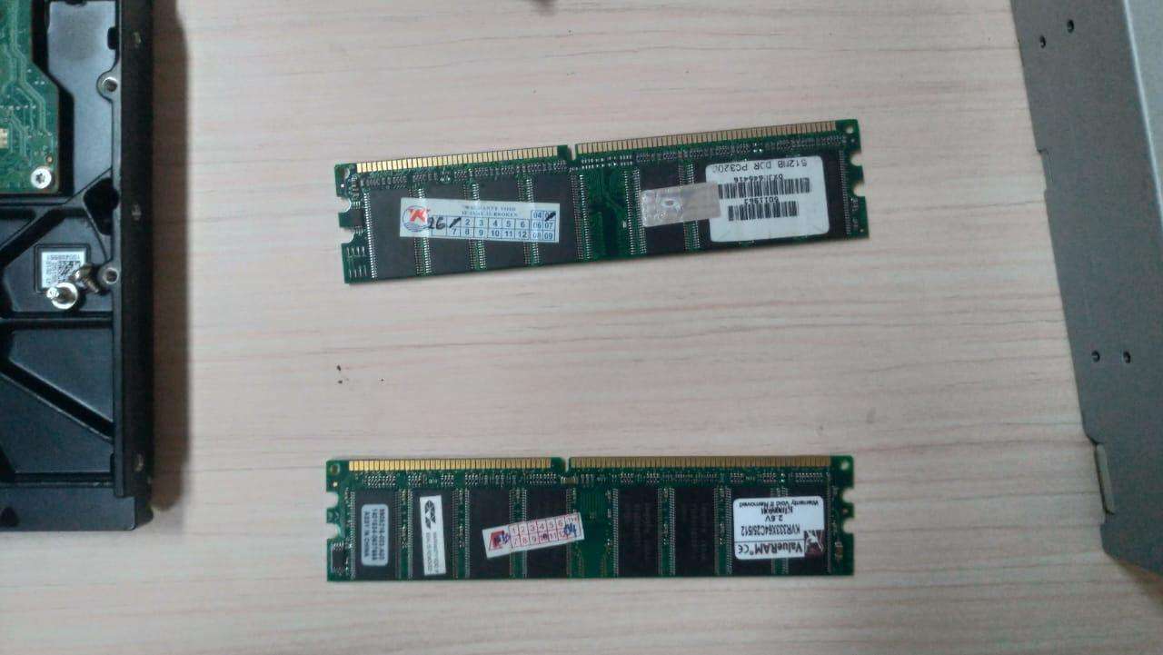
Hard disk Internal
Random Access Memory
Second RAM
CD-ROM
Brand : Seagate
Size : 250 GB
Type : barracuda 7200-12
Function : as storage in computer to save our data
Brand : Kingston
Size : 512 MB
Type : DDR2
Function : to store data for short-term use
Brand : Visipro
Size : 512 MB
Type : DDR2
Function : to store data for short-term use
Brand : Samsung
Type : SH-M522
Function : to read data from a CD. CD-ROM also means that the CD-ROM drive which can only be used to read a CD.

Slide 13
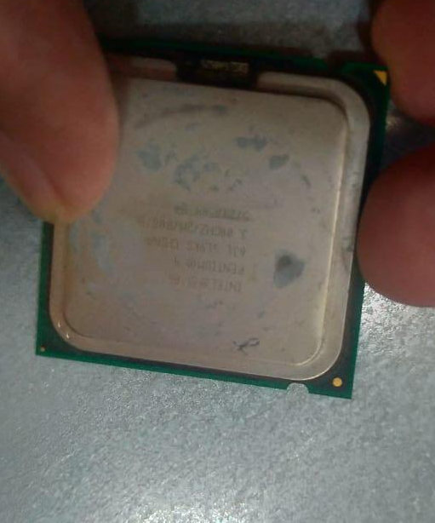
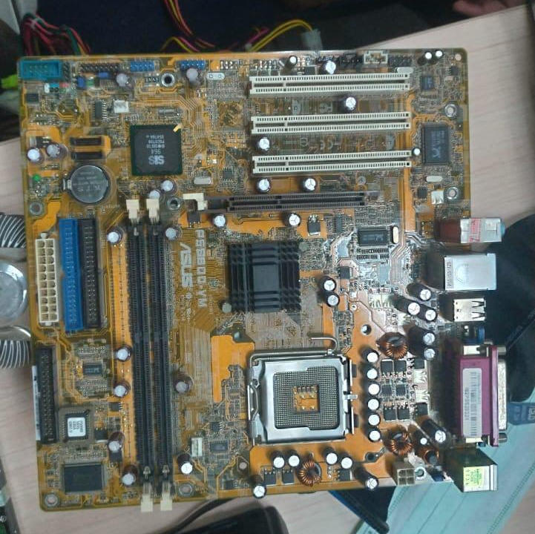
Motherboard
Processor’s Fan
Processor
Brand : ASUS
Type : PSSBDO-VM
Function : the function of the motherboard in general is to connect all the components of a computer
Brand : Intel
Size : -
Type : -
Function : to pull cooler air into the computer
Brand : Intel
Size : -
Type : Pentium Dual Core
Function : Carries out the instruction of a computer program

Slide 14

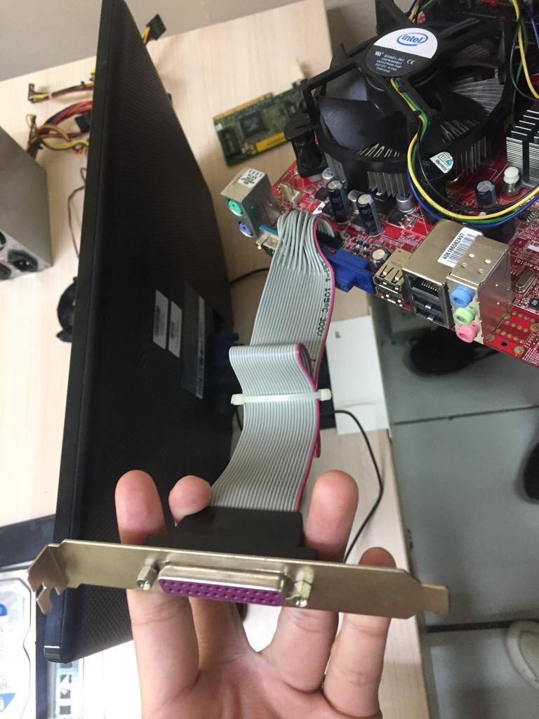
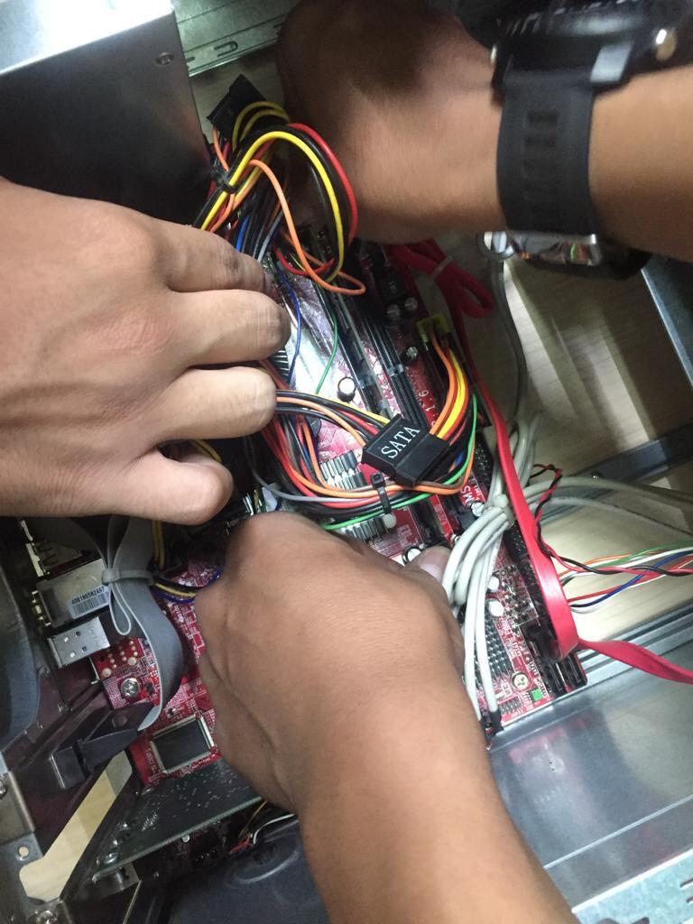
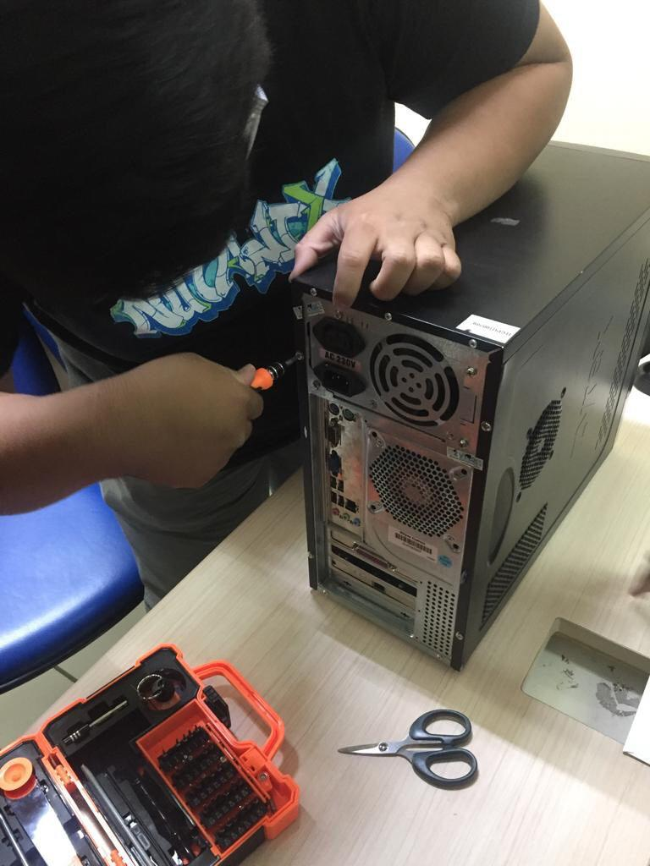
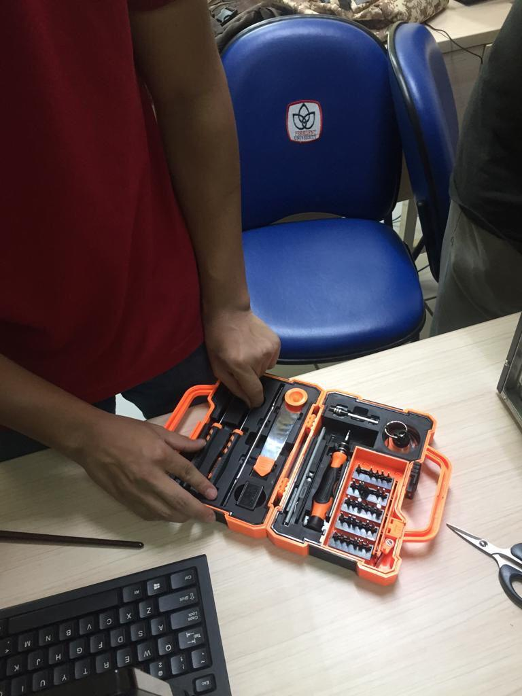
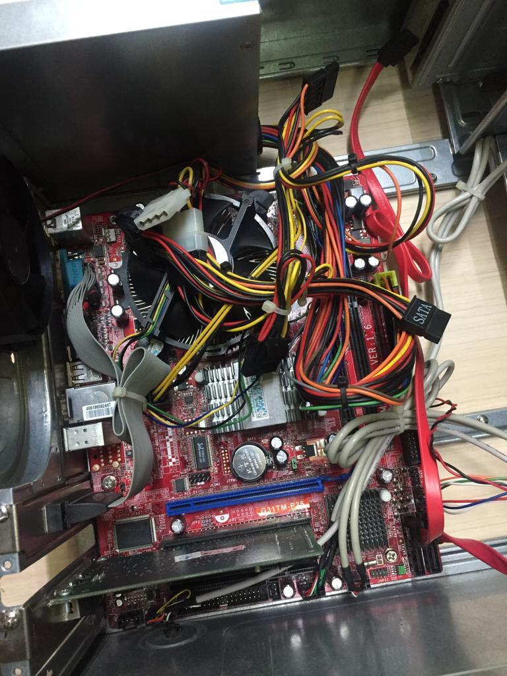
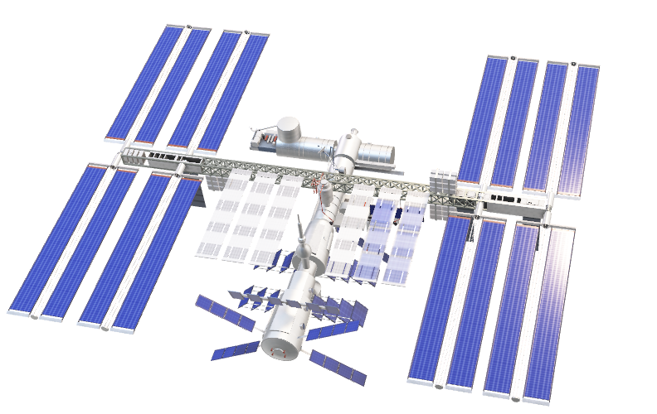
Some Documentation
Documentation 1
This Photo by Unknown Author is licensed under CC BY

Slide 15
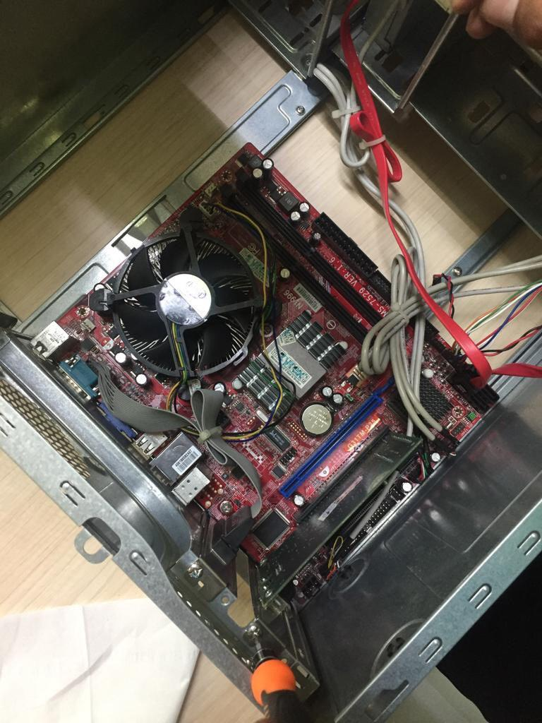
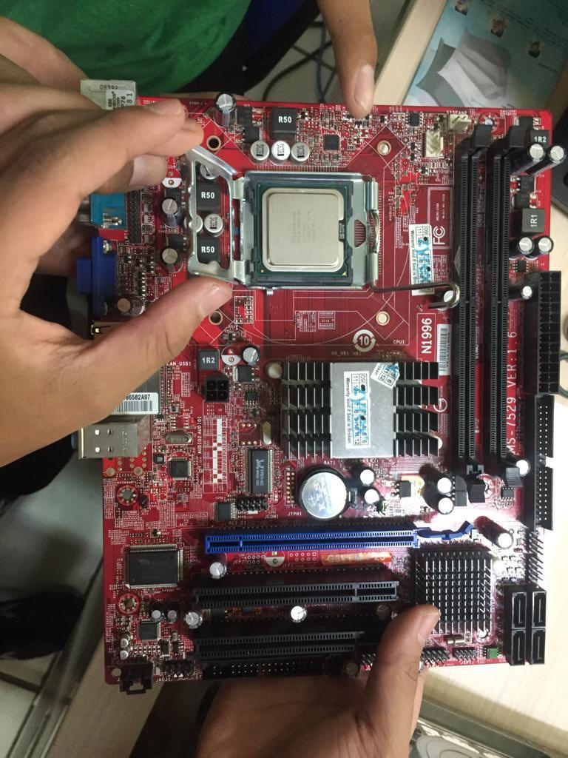
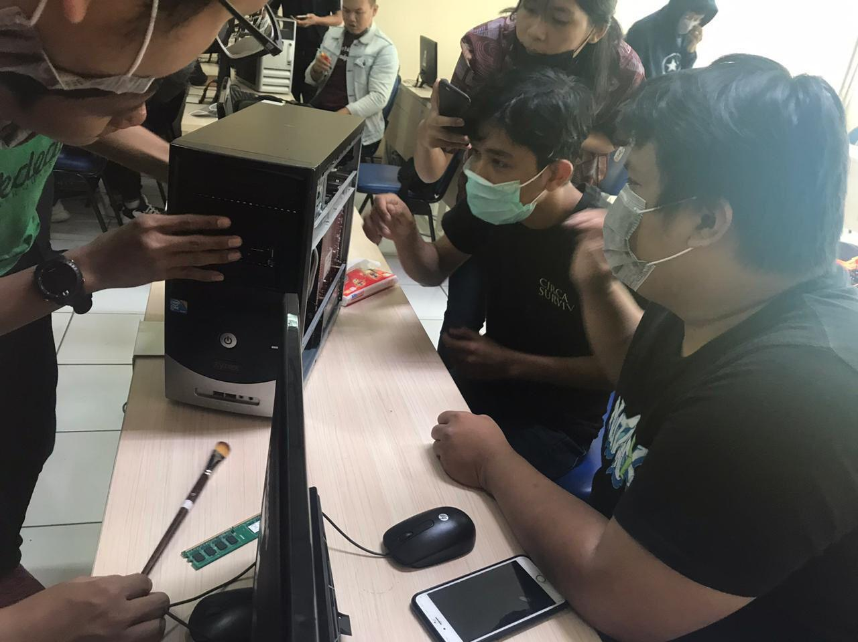
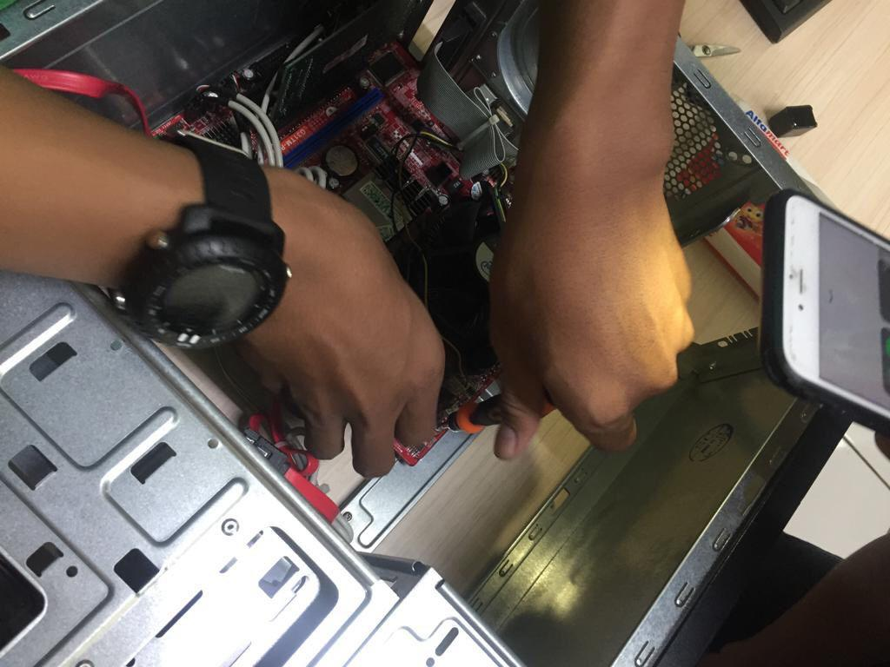
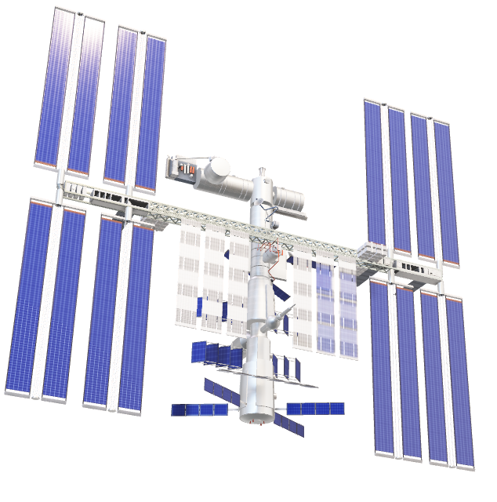
Some Documentation
Documentation 2
This Photo by Unknown Author is licensed under CC BY

Slide 16
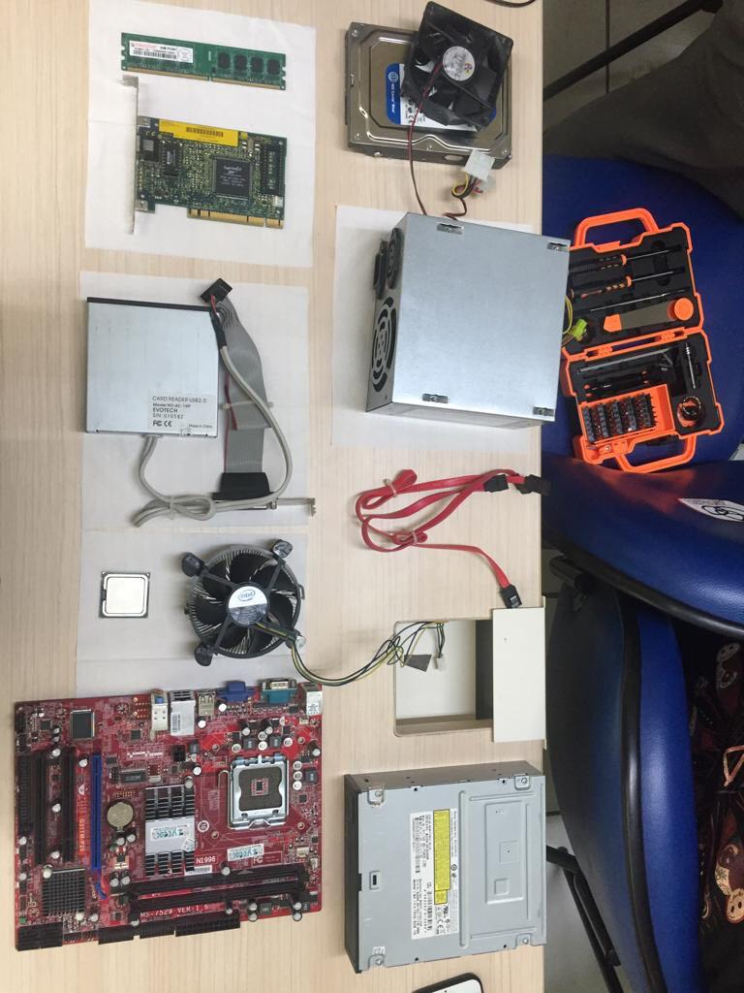
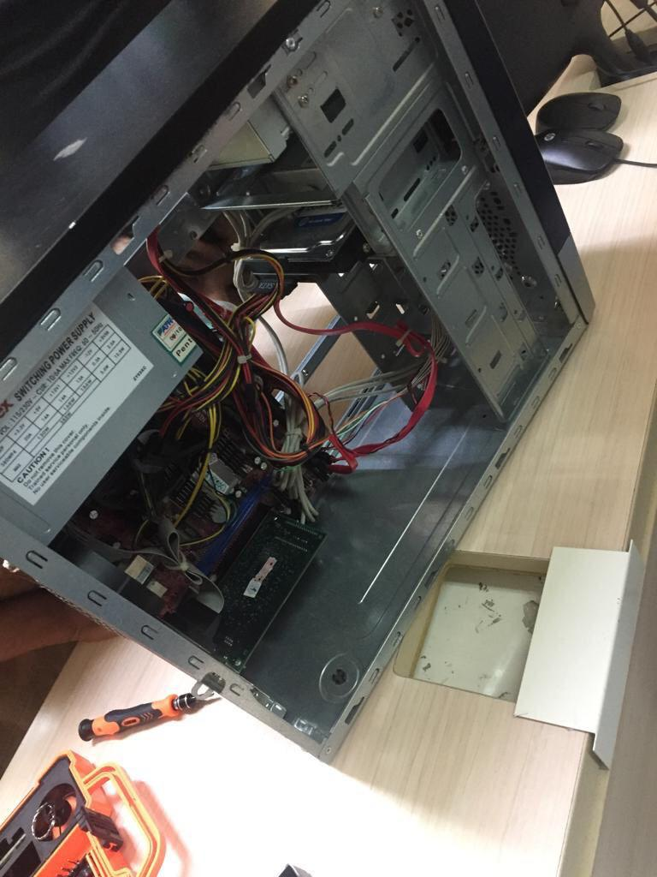
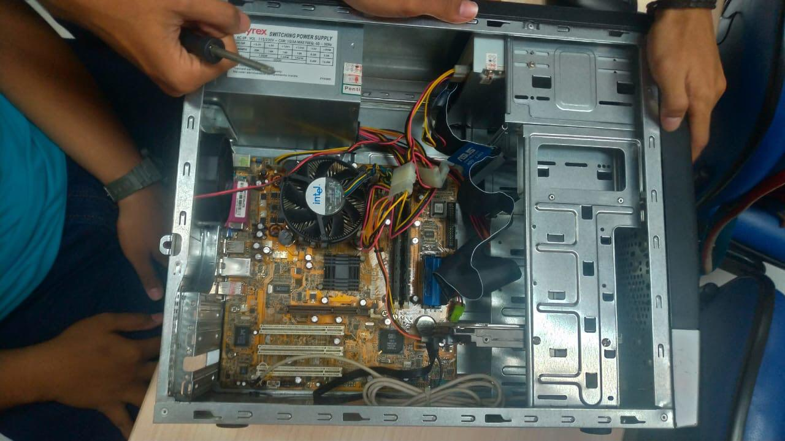
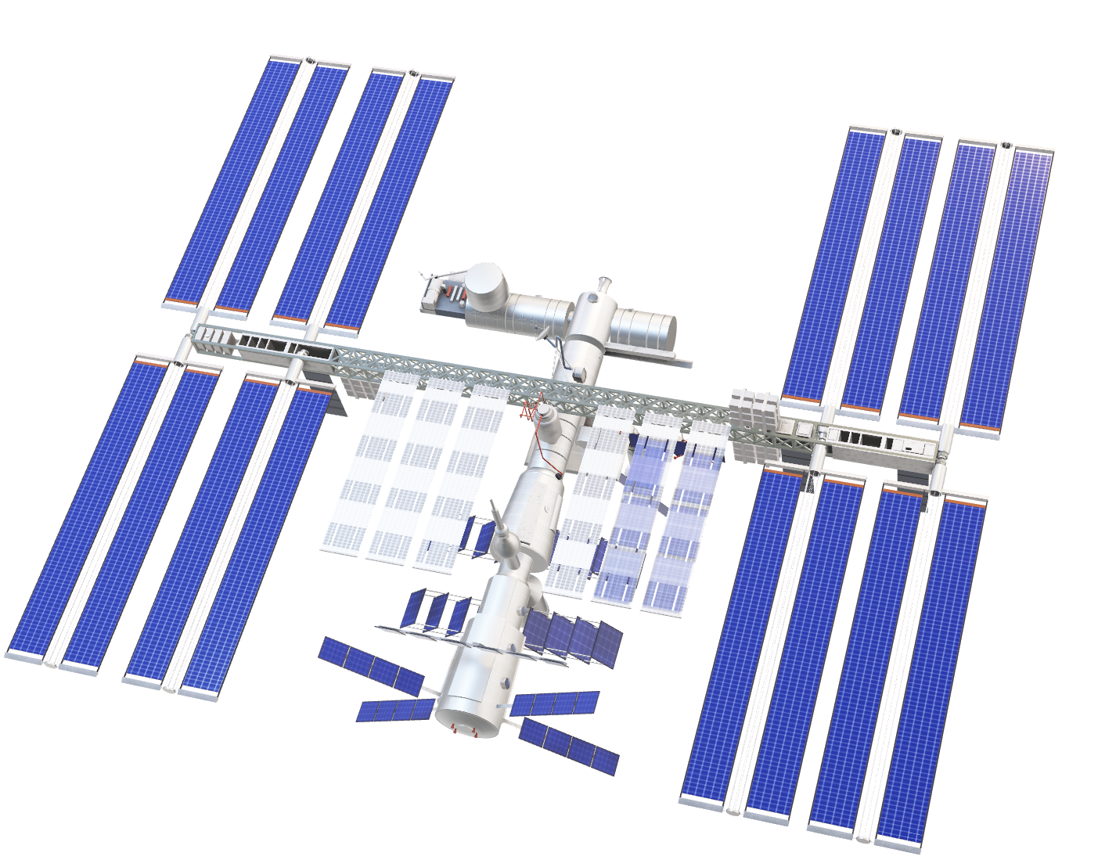
Some Documentation
Documentation 3
This Photo by Unknown Author is licensed under CC BY

Slide 17
Any Question ?

Slide 18
Thanks

